Slide 1
Online Retail Analysis – Key Insights
Analysis based on cleaned and validated 2011 online retail data.
Focused on providing actionable insights for CEO & CMO.

Slide 2
Data Cleaning & Preparation
Ensured quantity ≥ 1 (removed returns or negative quantities).
Ensured unit price ≥ $0 (corrected erroneous entries).
Applied conditional formulas and data transformation to exclude invalid data.
Result: Cleaned dataset ready for accurate analysis.

Slide 3
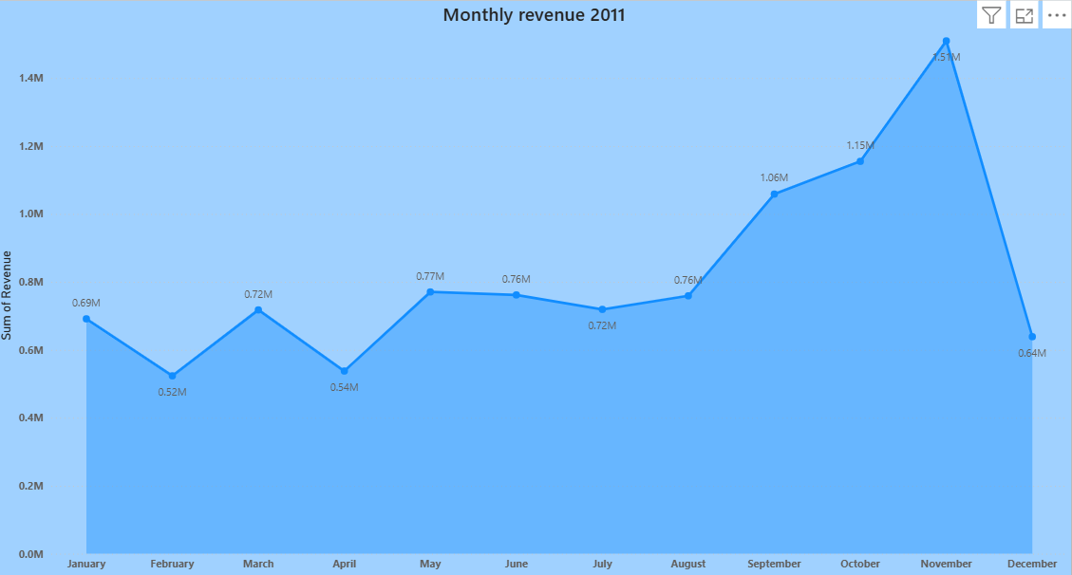
Monthly Revenue Trend – 2011
Line chart shows monthly revenue patterns.
Seasonal trends observed: peaks in December (holiday season), smaller spikes mid-year.
Insight: Understanding monthly trends helps with inventory planning and forecasting.

Slide 4
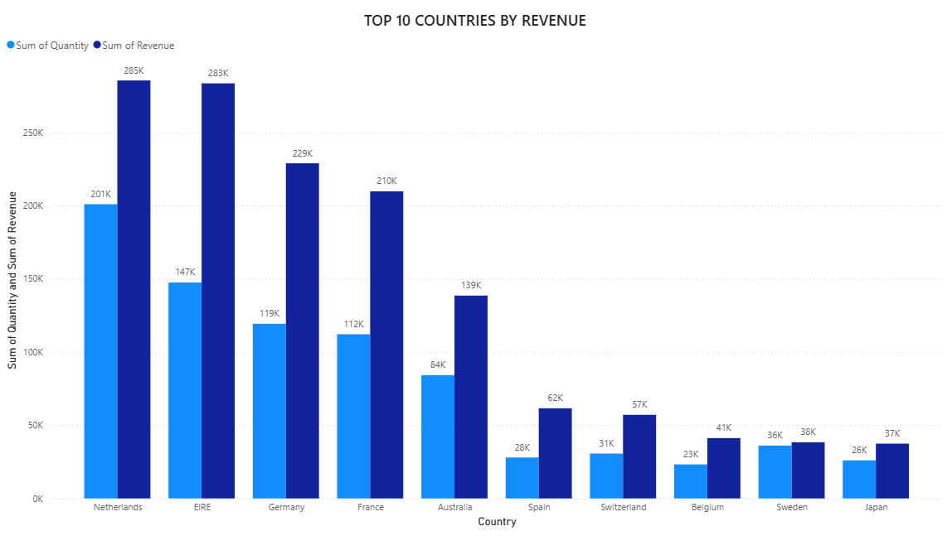
Top Revenue-Generating Countries (Excluding UK)
Highlighting top 10 countries by revenue.
Included quantity sold along with revenue.
Insight: Helps CMO understand markets generating most revenue and prioritize marketing strategies.

Slide 5
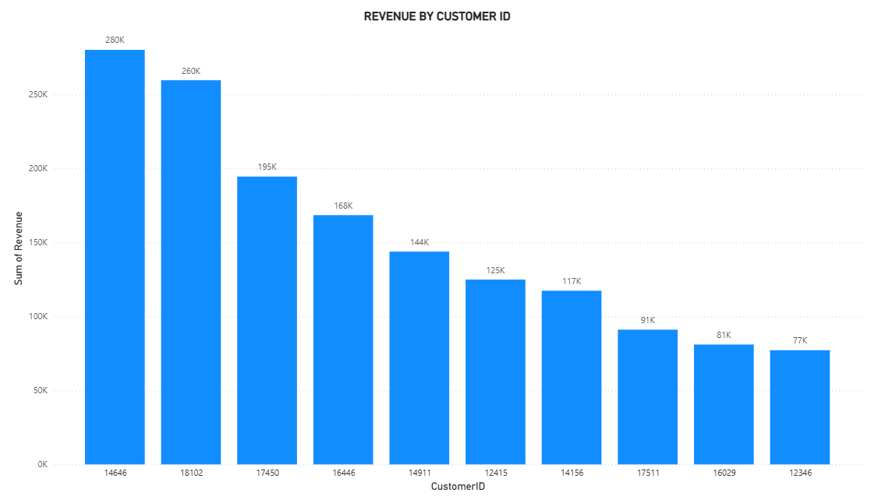
Top Customers by Revenue
Bar chart sorted descending by revenue, showing highest to lower revenue customers.
Insight: Identifies high-value customers for retention and personalized campaigns.
Enables targeted customer loyalty initiatives.

Slide 6
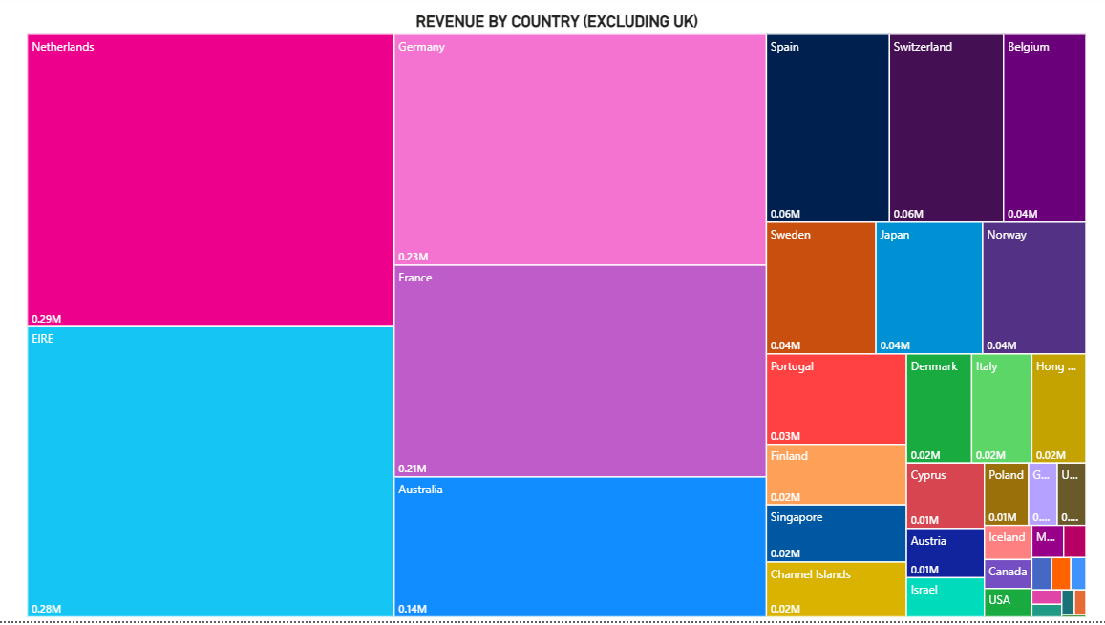
Regional Demand Insights (Excluding UK)
Visual shows demand per country/region.
Identifies regions with greatest growth potential for expansion.
All data on a single view for quick decision-making.

Slide 7
Key Takeaways & Recommendations
Seasonal trends identified → plan inventory & promotions accordingly.
Top countries & customers prioritized for marketing and retention strategies.
Expansion opportunities highlighted for high-demand regions.
Next Steps: Forecasting, targeted campaigns, and expansion strategies.

